Slide 1
Waste management – citizens engagement
Fragiskos Fourlas (1059336)
Marios Stamatopoulos (1059383)
Nikos Panagiotopoulos (1053552)

Slide 2
OUTLINE
Problem
Solution
Market Fill
Market Gap
Our Proposal

Slide 3
Workload Allocation
Gateways/Devices, Prediction, Reward System
(Fragiskos Fourlas)
Optimal Route, Server Structure, Database
(Marios Stamatopoulos)
Frontend Design and Structure, Data Analysis
(Nikos Panagiotopoulos)

Slide 4
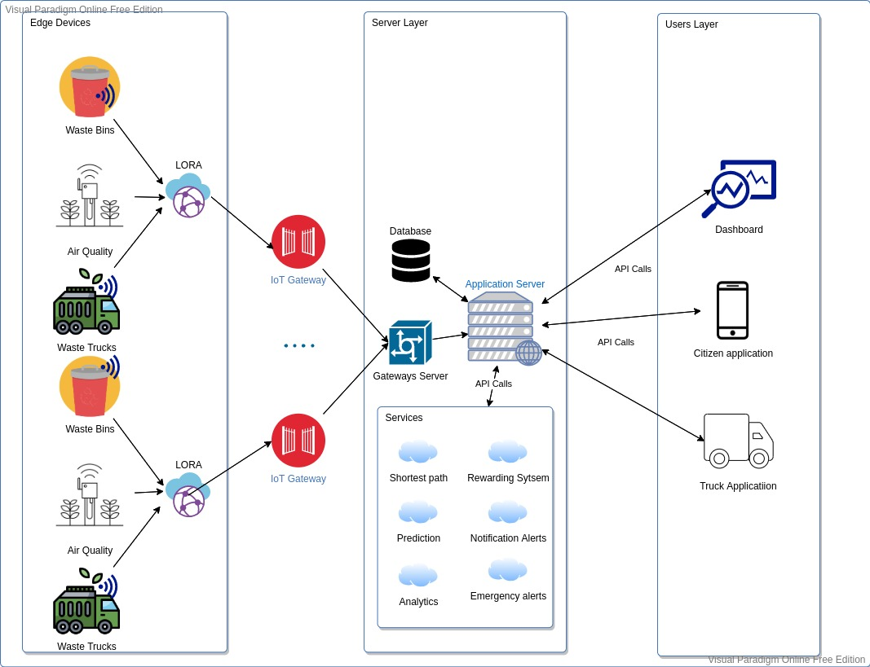
Our Proposal

Slide 5
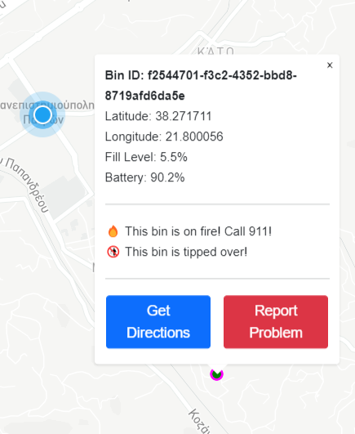
Dummy Sensors
Dummy Sensors Server
Collects data from the gateway and publishes it to the server
Handles API calls for I/O
Sensor Gateway
Works in the place of an actual IoT Gateway
Runs processes containing sensors
Transfers messages between sensors and server via pipes
Sensors
Have a unique identifying UUIDv4
Scatter themselves around a fixed center point
Update and publish mock data with a unique “measurement ID” each interval
Chance to fall or catch fire every interval

Slide 6
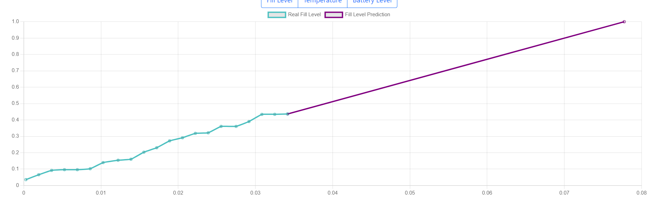
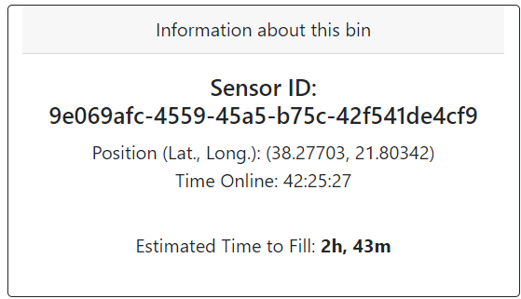
Regression Prediction
Uses measurement history to predict a fill rate
Prediction is calculated per sensor and saved individually in a DB table
If retrieved regression model is too old, prediction is recalculated and updated before response

Slide 7
Citizen Engagement – Point System
Announce Bounty
(e.g. Tilting bin, Empty battery)
Award Points
Citizens Redeem for Vouchers

Slide 8
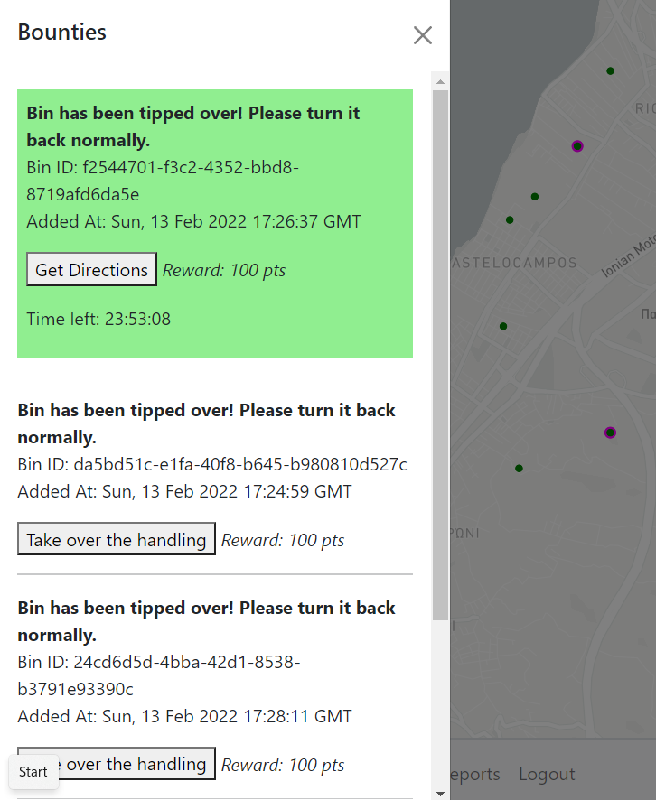
Bounties
Generation
A bounty is automatically generated when a bin makes a problematic measurement
Support for future development: Admin generated bounties for any purpose
User Interaction
User can find bounties in a radius around him
User accepts a bounty and has some time to complete it
User can find a list of his assigned bounties in his profile, mark it complete and receive the reward points or abandon

Slide 9
Known Issues
Major
Dummy Sensors bug (Launching creates 2 SensorGateways can only communicate with one)
Minor
Buttons on home page do not work, need to press “CleanerCity App” on the nav-bar
Fill level on bin history graph doesn’t display x-axis time
Some visuals don’t auto refresh

Slide 10

Questions?

